Slide 1
N of 1 Trials, Statistical Inference and Rare Diseases
Stephen Senn, Artur Araujo and Sonia Leite
Notes:
For indications and treatments where their use is possible, n-of-1 trials represent a promising means of investigating potential treatments for rare diseases. Each patient permits repeated comparison of the treatments being investigated and this both increases the number of observations and reduces their variability compared to conventional parallel group trials.
However, depending on whether the framework for analysis used is randomisation-based or model- based produces puzzling difference in inferences. This can easily be shown by starting on the one hand with the randomisation philosophy associated with the Rothamsted school of inference and building up the analysis through the block + treatment structure approach associated with John Nelder’s theory of general balance (as implemented in GenStat®) or starting on the other hand with a plausible variance component approach through a mixed model. However, it can be shown that these differences are related not so much to modelling approach per se but to the questions one attempts to answer: ranging from testing whether there was a difference between treatments in the patients studied, to predicting the true difference for a future patient, via making inferences about the effect in the average patient.
This in turn yields interesting insight into the long-run debate over the use of fixed or random effect meta-analysis.
Some practical issues of analysis will also be covered in R and SAS®, in which languages some functions and macros to facilitate analysis have been written. It is concluded that n-of-1 hold great promise in investigating chronic rare diseases but that careful consideration of matters of purpose, design and analysis is necessary to make best use of them.
Acknowledgement
This work is partly supported by the European Union’s 7th Framework Programme for research, technological development and demonstration under grant agreement no. 602552. “IDEAL”

Slide 2
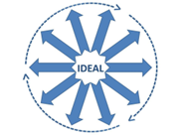
Acknowledgements
This work is partly supported by the European Union’s 7th Framework Programme for research, technological development and demonstration under grant agreement no. 602552. “IDEAL”
(c) Stephen Senn
2
Notes:
Artur Araujo is doing a PhD with me on methods for designing and analysing n-of-1 studies. Sonia Leite is a statistician in my group who has produces a number of macros in SAS® to analyse n-of-1 trials

Slide 3
Rare Diseases
As far as the Food and Drug Administration is concerned anything that affects fewer than 200,000 people in the US
However many diseases are much rarer than this
But there are at least 7,000 rare diseases
Thus the total number of persons effected is considerable

Slide 4
Possible objectives of an analysis
Is one of the treatments better?
Significance tests
What can be said about the average effect in the patients that were studied?
Estimates, confidence intervals
What can be said about the average effects in future patients?
What can be said about the effect of a given patient in the trial?
What can be said about a future patient not in the trial?
Notes:
I don’t have time to cover all of these, so I will just look at the three in bold

Slide 5
Two different philosophies
Randomisation philosophy
Sampling philosophy
The patients in a clinical trial are taken as fixed
The population about which inference is made is all possible randomisations
The patients don’t change, only the pattern of assignments of treatments change
This approach is relatively rare
Patients are regarded as a sample from some population
The population about which inference is made is some (hypothetical) population
This is usually handled by adding error terms corresponding to various components of variance
This approach is much more common

Slide 6
N-of-1 studies
Studies in which patients are repeatedly randomised to treatment and control
Increased efficiency because
Each patient acts as own control
More than one judgement of effect per patient
However, only possible for chronic diseases
Possible randomisation in k cycles of treatment
Implies $2^{k}$ possible sequences
Notes:
This shows a case where two patients are treated in three cycles each cycle consisting of a pair of periods in one of which treatment A is delivered and in one of which treatment B is given
The order of treatments is randomised within cycles

Slide 7
Chen and Chen (2014)
Paper on n of 1 trials in PLOS One
Considered appropriate analyses of n of 1 trials randomised in cycles
Compared performance of various analyses and compared them via simulation
Amongst the various approaches they investigated was the matched pairs design where ‘pair’ was defined by a cycle
Found this performed well
My initial reaction on seeing this is that this is wrong but on closer examination there is a sense in which it can be justified
Notes:
1. Chen X, Chen P. A comparison of four methods for the analysis of N-of-1 trials. PloS one. 2014;9(2):e87752. doi: 10.1371/journal.pone.0087752. PubMed PMID: 24503561; PubMed Central PMCID: PMC3913644.

Slide 8
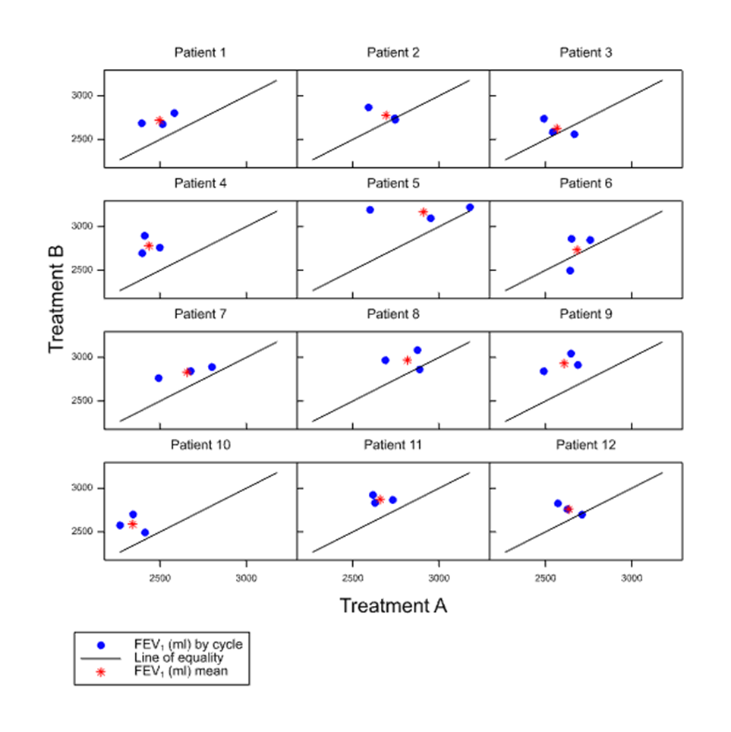
Simulated example
Twelve patients suffering from a chronic rare respiratory complaint
For example cystic fibrosis
Each patient is randomised in three pairs of periods, comparing two treatments A and B
Adequate washout is built in to the design
Thus we have 12 x 3 x 2 = 72 observations altogether
Efficacy is measured using forced expiratory volume in one second (FEV₁) in ml
How should we analyse such an experiment?
Notes:
This shows a case where two patients are treated in three cycles each cycle consisting of a pair of periods in one of which treatment A is delivered and in one of which treatment B is given
The order of treatments is randomised within cycles

Slide 9
Is one of the treatments better? Significance tests
General Balance
Establish and define block structure
Establish and define treatment structure
Given randomisation the analysis then follows automatically
Here the block structure is
Patient/Cycle GenStat®
Patient(Cycle) SAS®
The treatment structure is
Treatment
Rothamsted School
Leading statisticians such as Fisher, Yates, Nelder, Bailey
Developed analysis of variance not in terms of linear models but in terms of symmetry
High point was John Nelder’s theory of general balance (1965)
Notes:
1. Nelder JA. The analysis of randomised experiments with orthogonal block structure I. Block structure and the null analysis of variance. Proceedings of the Royal Society of London Series A. 1965;283:147-62.
2. Nelder JA. The analysis of randomised experiments with orthogonal block structure II. Treatment structure and the general analysis of variance. Proceedings of the Royal Society of London Series A. 1965;283:163-78.

Slide 10
How the Rothamsted School approach works
The bock structure of the experiment is established
This is cycles within patients
Patient/Cycle = Patient+Patient.Cycle for GenStat®
Patient/Cycle = Patient+Patient:Cycle for R
Patient(Cycle) = Patient Patient(Cycle) for SAS®
The treatment structure is established
For all three packages this is simply Treatment
The outcome variable is declared
Given the design matrix the analysis now follows
This is fully implemented in GenStat® In other packages it has to be programmed

Slide 11
The general balance approach in GenStat®
BLOCKSTRUCTURE Patient/Cycle
TREATMENTSTRUCTURE Treatment
ANOVA[FPROBABILITY=YES;NOMESSAGE=residual] Y
.
Analysis of variance
Variate: FEV₁ (mL)
Source of variation d.f. s.s. m.s. v.r. F pr.
Patient stratum 11 1458791. 132617. 10.04
Patient.Cycle stratum 24 316885. 13204. 1.04
Patient.Cycle.*Units* stratum
Treatment 1 641089. 641089. 50.57 <.001
Residual 35 443736. 12678.
Total 71 2860501.

Slide 12
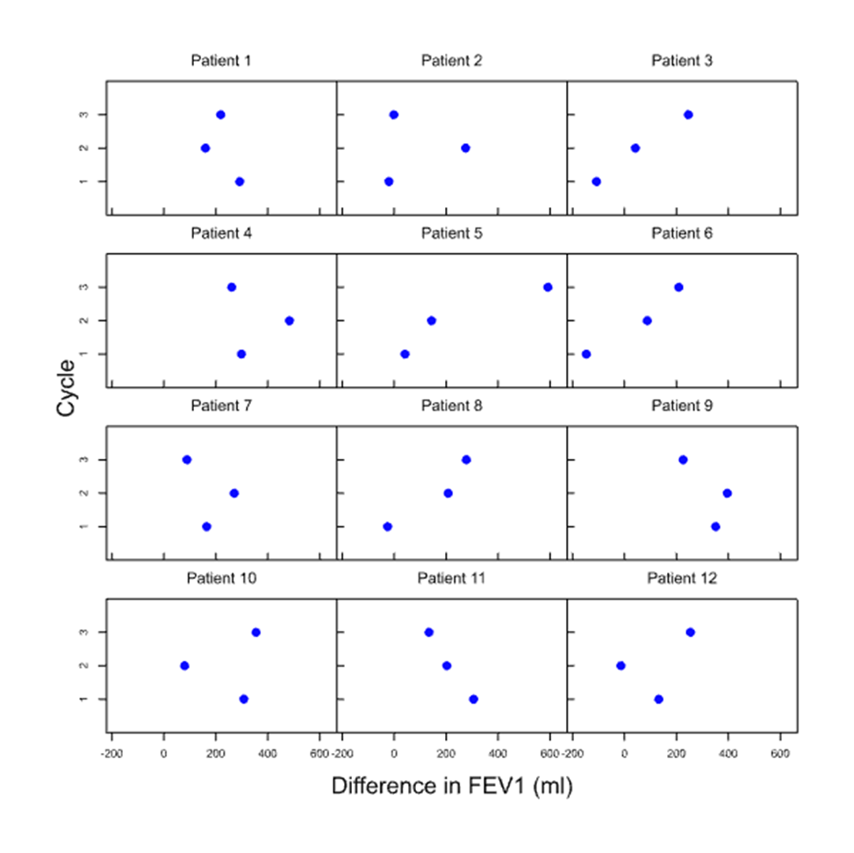
What about the matched pairs approach?
We don’t analyse the original data
Instead we reduce everything to a difference between pairs
In this case ‘pair’ is defined by patient and cycle within patient
There are thus 12 x 3 = 36 pairs in total
The trellis plot corresponding to this is on the right
Instead of plotting B against A it shows B-A per cycle per patient

Slide 13
Matched pairs t using cycles to define pair
One-sample t-test
Variate: Diff.
Summary
Standard Standard error
Sample Size Mean Variance deviation of mean
Paired difference 36 188.7 25356 159.2 26.54
95% confidence interval for mean: (134.8, 242.6)
Test of null hypothesis that mean of Paired difference is equal to 0
Test statistic t = 7.11 on 35 d.f.
Probability < 0.001
Chen and Chen approach is OK after all!
Same DF as for ANOVA & is one fewer than total number of cycles
7.11²= 50.57 This analysis is equivalent to the previous ANOVA

Slide 14
Consequences
The matched pairs t-test examined by Chen and Chen (2014) is a valid analysis
It is justified by the randomisation theory of the Rothamsted School and by John Nelder’s approach
However, one must be careful
It is a valid analysis for testing a specific null
That the two treatments are identical
In this case under the null hypothesis, the interaction is zero
This raises the question can we do better?
We can go one step further and remove the treatment by patient interaction from the residual sum of squares
Under the null hypothesis the expected value of the interaction is no different from the residual
However if the alternative is true we can use a smaller residual sum of squares
This is analogous to the following idea when carrying out a two-sample t-test
Despite the fact that under the null hypothesis a variance estimate using
$n_{1}+n_{2}$-1 is more accurate than one using $\left(n_{1}−1\right)+\left(n_{2}−1\right)$, we use the latter because it is better under the alternative hypothesis

Slide 15
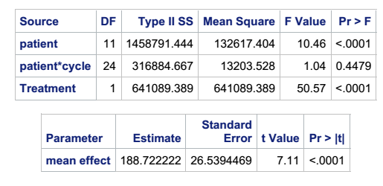
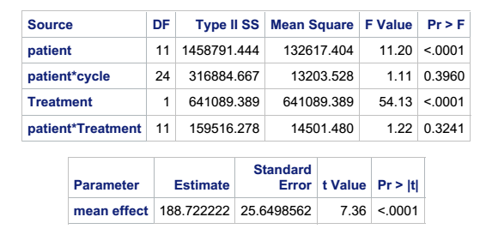
Comparing two models
The first is without a patient by treatment interaction
NB Analysis with proc glm of SAS®
The second is with a patient by treatment interaction
Notes:
These two analyses answer the first of the two questions
Note that the use of an asterisk for an interaction is peculiar to SAS for both R and GenStat A*B means main effect of A plus main effect of B plus interaction of A and B
In R the interaction itself would be written A:B and in GenStat A.B
Nested factors are A/B in R® and GensStat® and A(B) in SAS®
Here the block structure is Patient/Cycle which is Patient Cycle*Patient in SAS® and Patient +Cycle.Patient in GenStat®
Nelder’s theory of General Balance says that this MUST be fitted in any model if this is the block structure

Slide 16
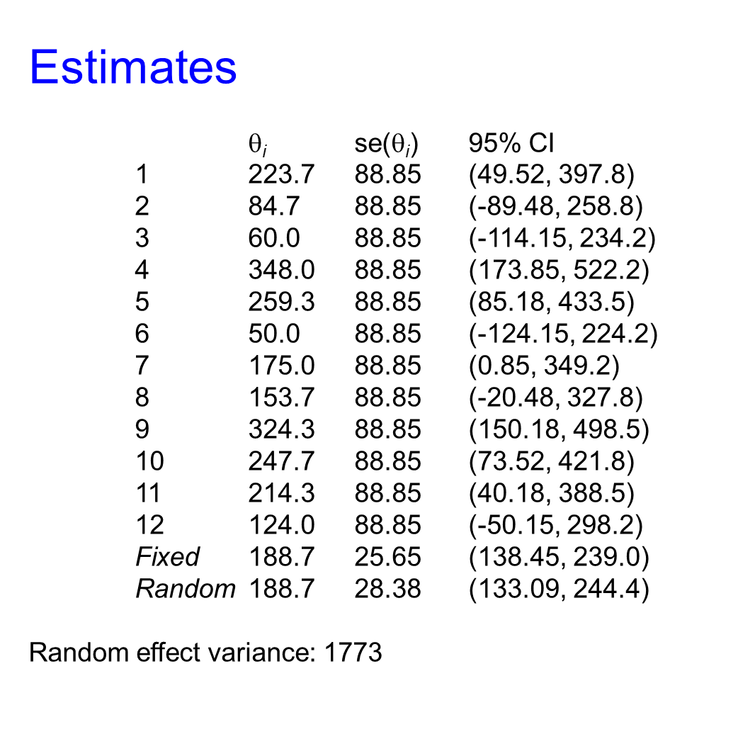
Meta-analysis
The ANOVA with interaction corresponds to the fixed effects meta-analysis

Slide 17
Two more difficult questions
The average effects in future patients?
The average effect for a given patient?
This may require a mixed effects model
Allow for a random treatment-by-patient interaction
The possibility that there may be variation in the effect from patient to patient
Strong assumptions my be involved
The same random effect model can be used to predict long-term average effects for patients in the trial
A weighted estimate is used whereby the patient’s only results are averaged with the general result

Slide 18
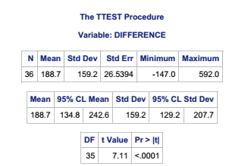
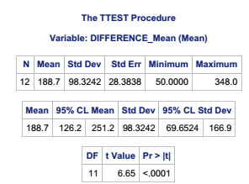
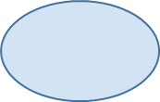
Two simple analyses
Based on 36 pairs (3 per patient)
Based on 12 averages (one per patient)

Slide 19
Careful. These are the fixed effects in a mixed model!
Solution for Fixed Effects
Standard
Effect Treatment_ Estimate Error DF t Value Pr > |t|
Intercept 2625.75 45.2031 11 58.09 <.0001
Treatment_ B 188.72 28.3838 11 6.65 <.0001
Treatment_ A 0 . . . .
Type 3 Tests of Fixed Effects
Num Den
Effect DF DF F Value Pr > F
Treatment_ 1 11 44.21 <.0001

Slide 20
Meta-analysis
The mixed model corresponds to the random effects meta-analysis

Slide 21
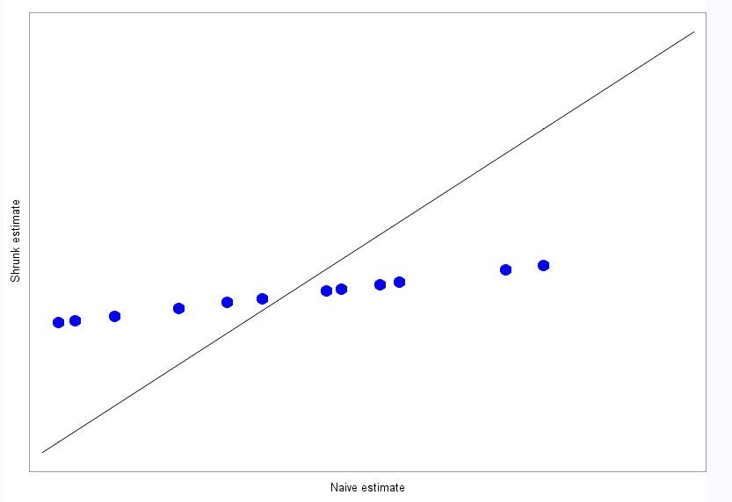

Slide 22
The two worlds
Proving a treatment can have an effect
Predicting what the effect will be
ANOVA with interaction
Equivalent to fixed effects meta-analysis
Summary measures approach (in the balanced case)
Mixed model
Random effects meta-analysis

Slide 23
Morals
Purpose
Analysis Design
There is still a role for small data analysis
Design is crucial
Analysis depends on purpose
And also on design and vice versa
Results depend on philosophical framework
Calculation is difficult, yes, but so is thinking

